Slide 1
Assasin’s creed odyssey

Slide 2
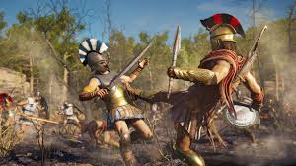
The Goal grafiques

Slide 3
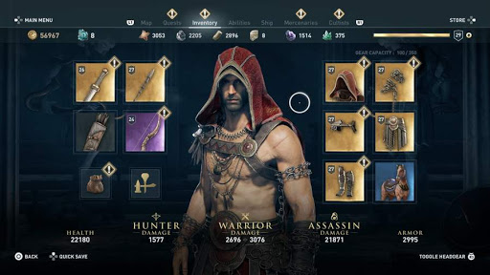
Armor and weapon

Slide 4
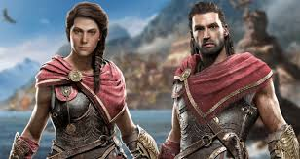
characters

Slide 5
https://www.youtube.com/watch?v=NJpD-DllvnU

